Slide 1
PONY Baseball & Softball
Tournament Team Eligibility Affidavit (TTEA)

Slide 2
Database for
ALL STAR AFFIDAVITS
This is an ONLINE system that will require the following information
  League and League Contact Information
  Manager/Coach Information
  Player Information
  Parent Information
League registration into the system is required
  Email will be sent by Region/State Director to League President
President or representative will create team shells (blank affidavits) for All Star Tournament Teams
Manager will build the Affidavit
  Manager/coach/player/parent information
Process is outlined in the following slides

Slide 3
Process Overview
Step 1
  League president REGISTERS his/her league in the new Affidavit system if not done previously
Step 2
  League president CREATES a shell (blank affidavit) for each All Star Tournament Team
Step 3
  Manager acknowledges administrative requirements
  Manager builds the affidavit
    Manager, Coach, Business Manager, Player and Parent information
Printing of the affidavit and obtaining signatures remains as in the past with the addition of parent/guardian is now required to sign the affidavit acknowledging the medical release statement on the affidavit

Slide 4
Director initiates contact with leagues for All Star Team Counts
Region/State director sends email to league president or designated rep
Email will contain link to database for them to CREATE a league account
After the president creates their league account they can ADD All Star teams for their league
Emails sent to each designated manager with login information by system
Managers will create the Affidavit at this point
President will have login and password for all teams as well. Region/State Director will also be able to retrieve

Slide 5
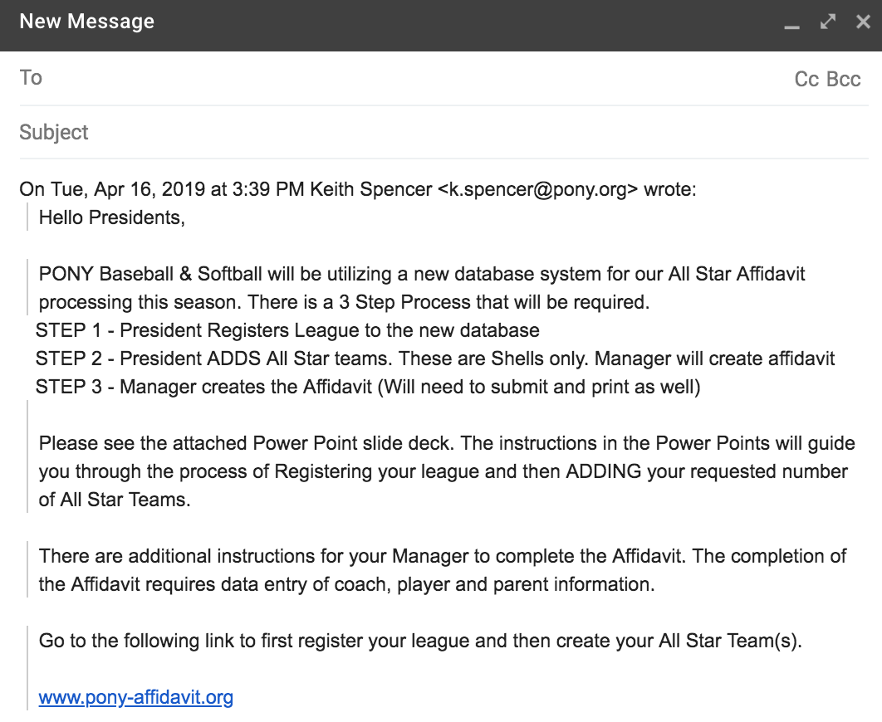
Sample Email

Slide 6
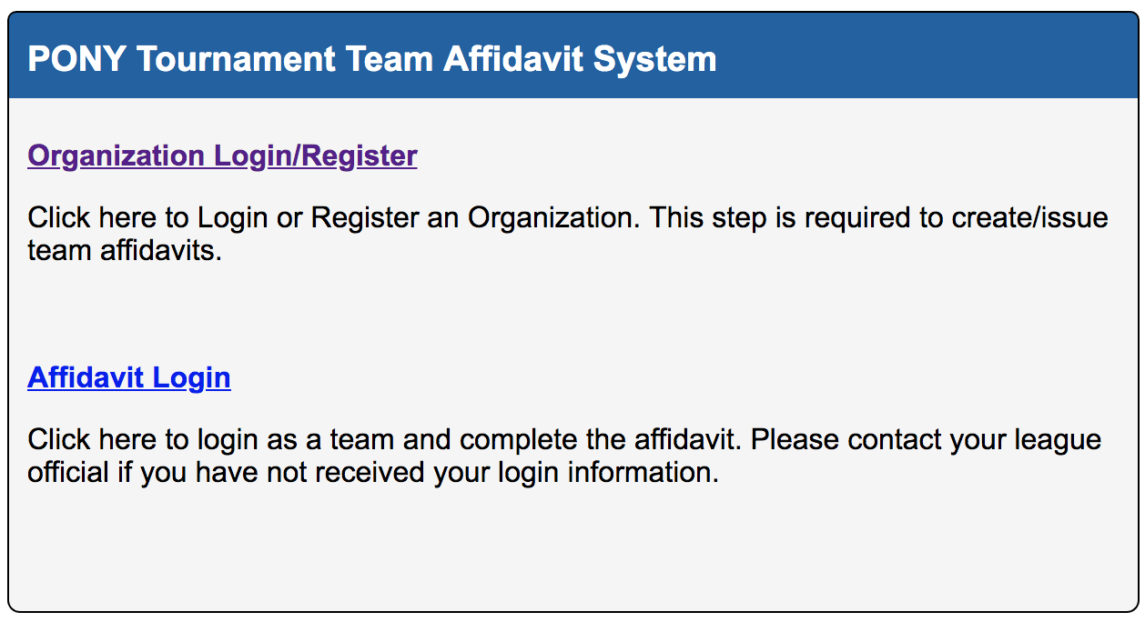
League representative clicks on link from Director
LINK to TTEA Database is www.pony-affidavit.org
Click on Organization Login/Register

Slide 7
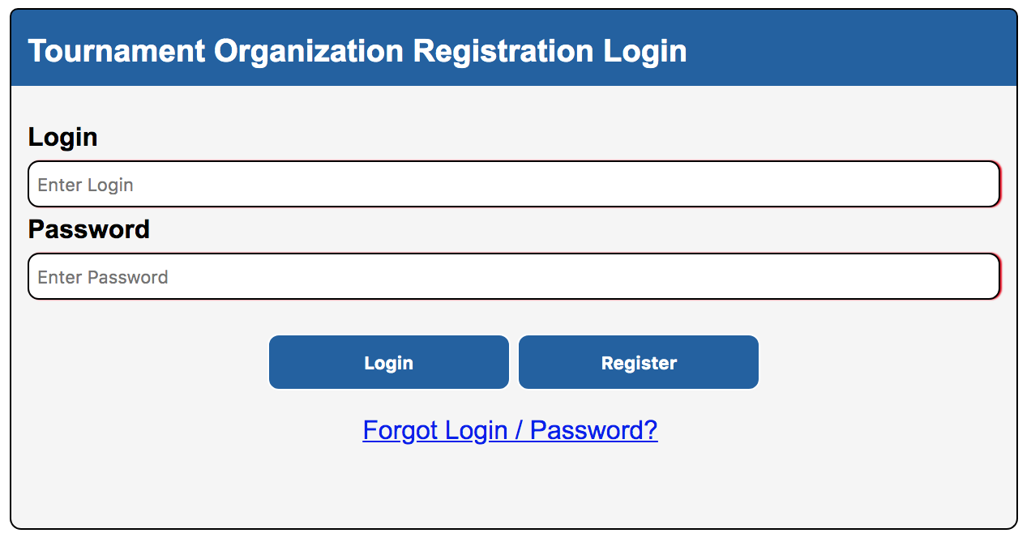
Click Register to create account
DO NOT ENTER LOGIN or PASSWORD INFO YET

Slide 8
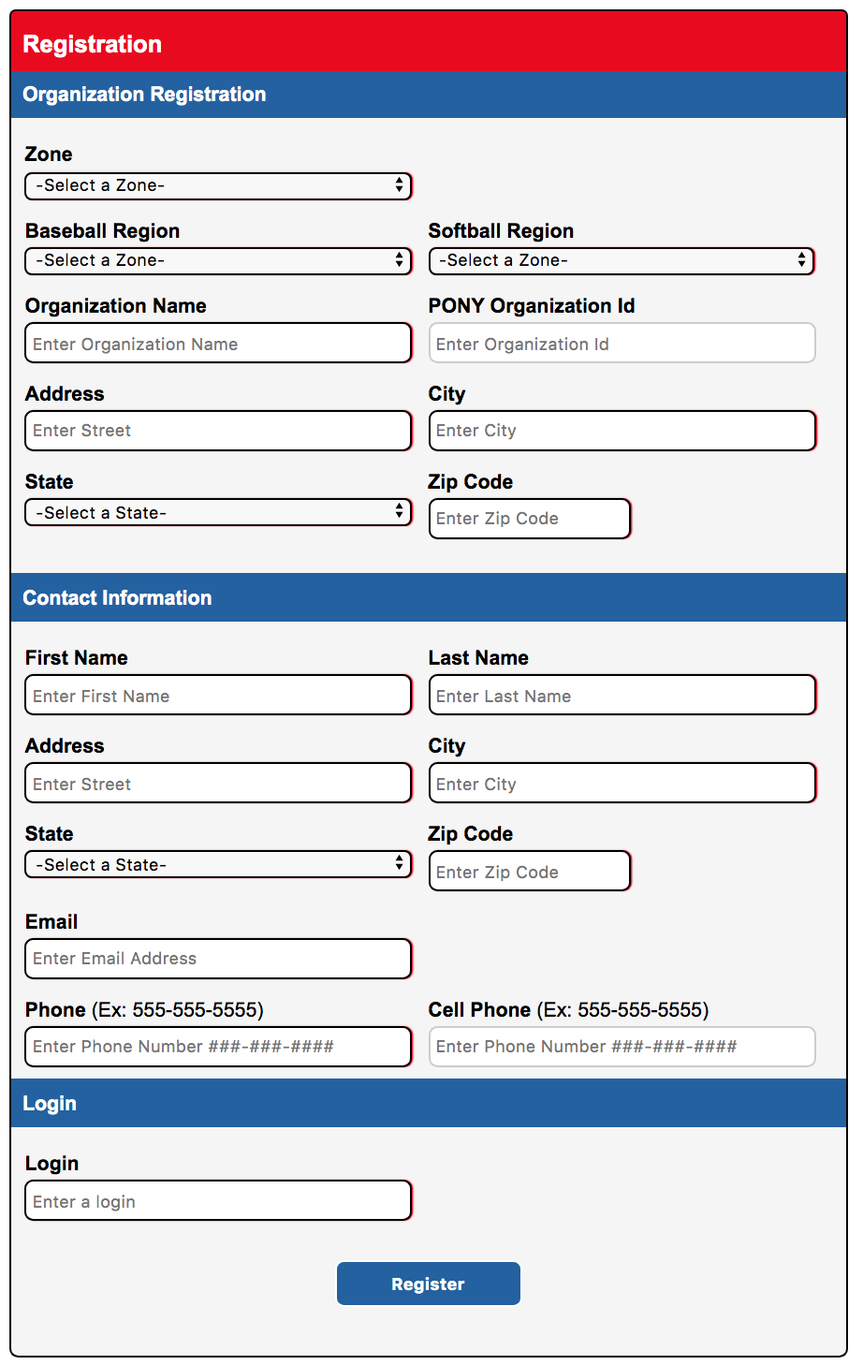
Main Registration Landing Page
Part 1
Part 1
Part 1

Slide 9
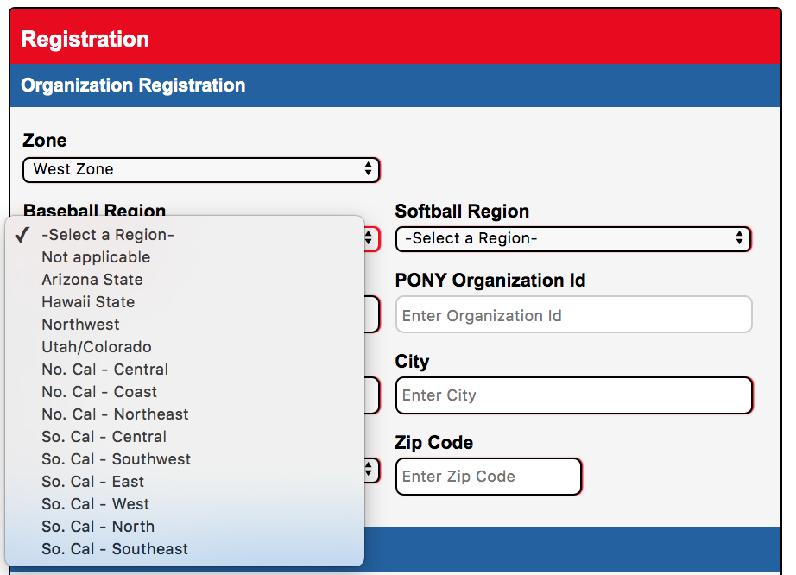
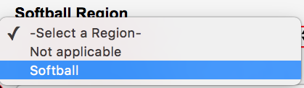
League Information (Part 1)
Primary Field Location Information
Select the Zone your league plays in
Select the Region for Baseball (If applicable)
If League is entering Softball select Softball or select Not Applicable
* May be Baseball, Softball or Both if league has All Star Teams for both
1.
3.
2.
Affinity/PONY Organization Id
is league Membership Id
when you registered
with PONY.
MANDATORY TO HAVE THIS

Slide 10
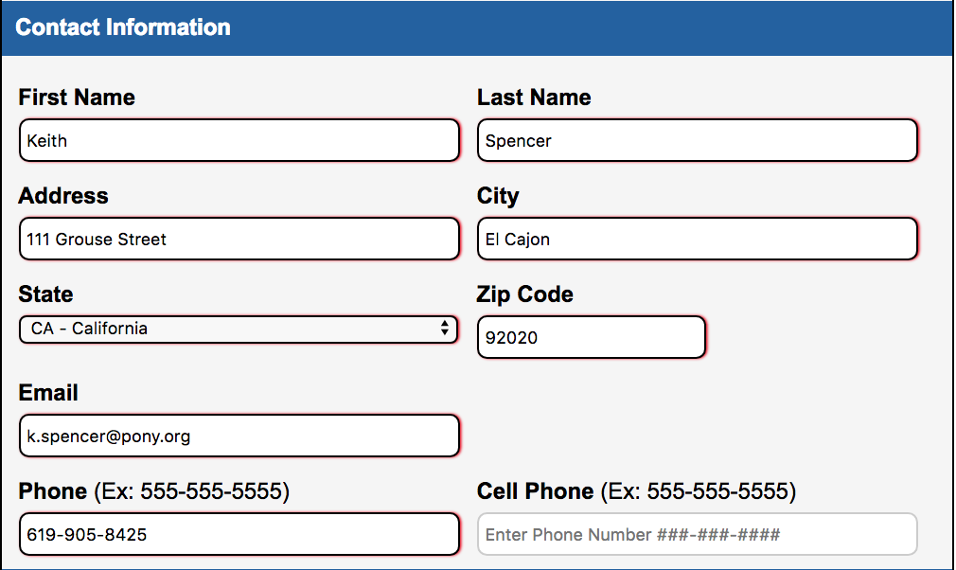
League Information (Part 2)
Enter League Contact Information

Slide 11
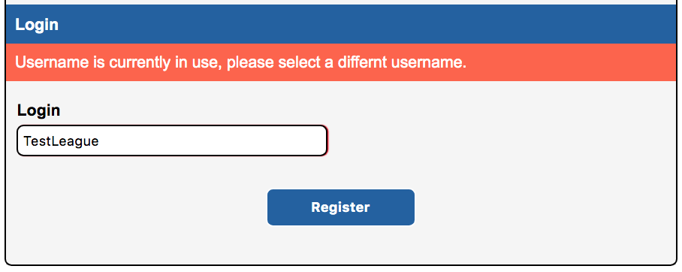
League Information (Part 3)
Create Login Name
Create a User Name under Login. Click on Register.
User Name must be unique.
This will be the User Name for your League Account.

Slide 12
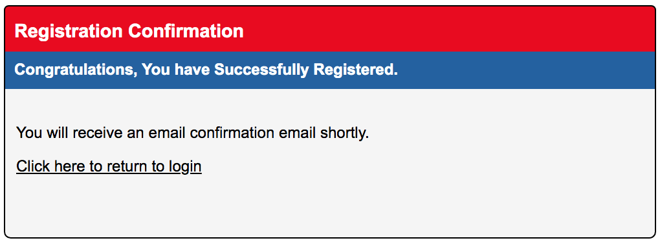
Successfully Created League Account
CHECK YOUR EMAIL!

Slide 13
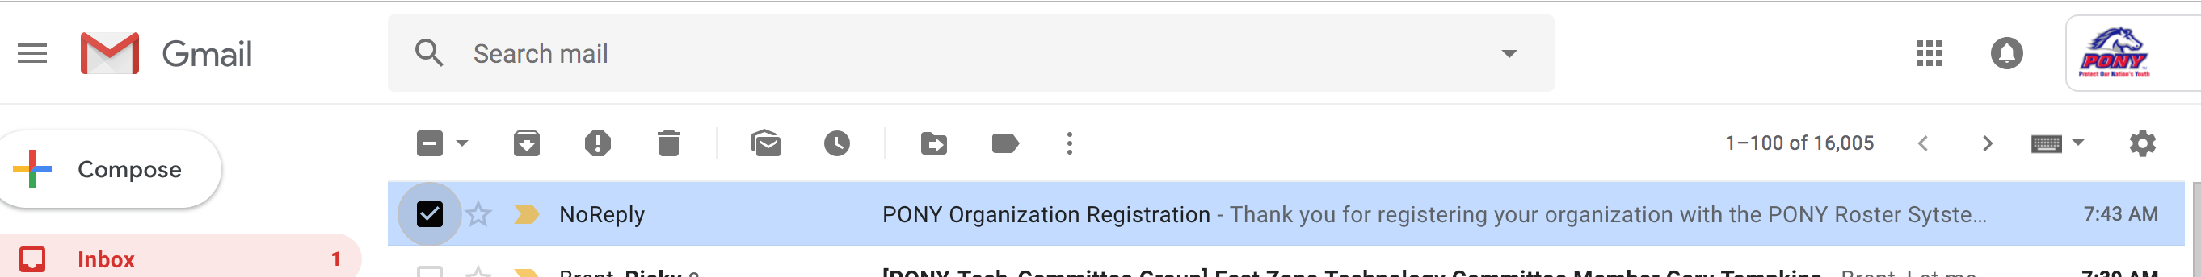
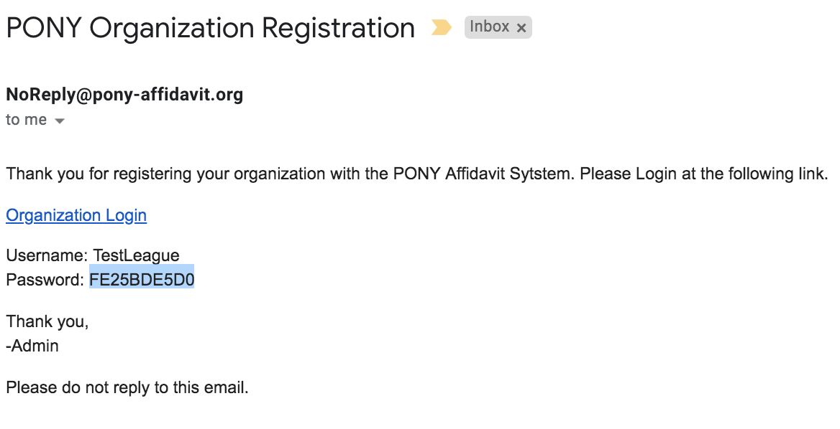
Automated Email to League Contact
Log In Using Email Link / Info

Slide 14
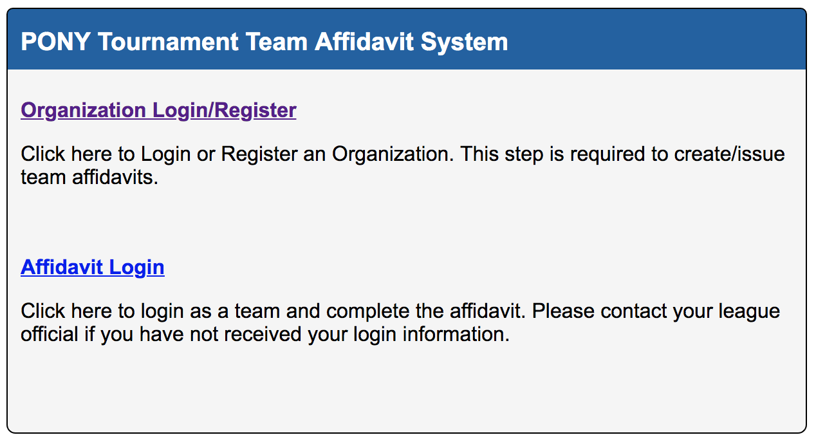
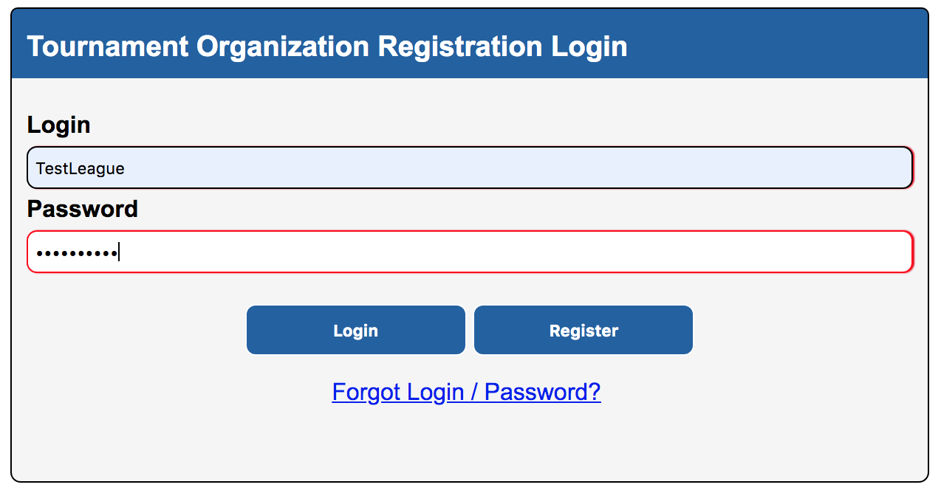
Log Back Into System Using
User Name and Password from Email

Slide 15
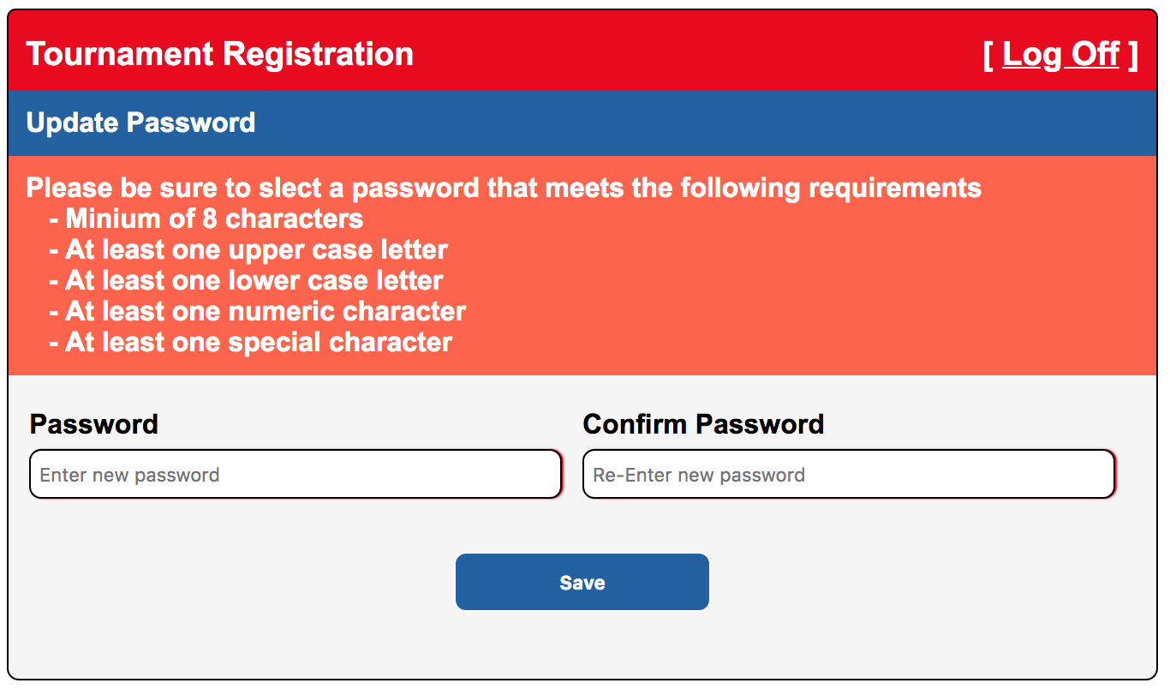
Login
(Password Change Is Required)

Slide 16
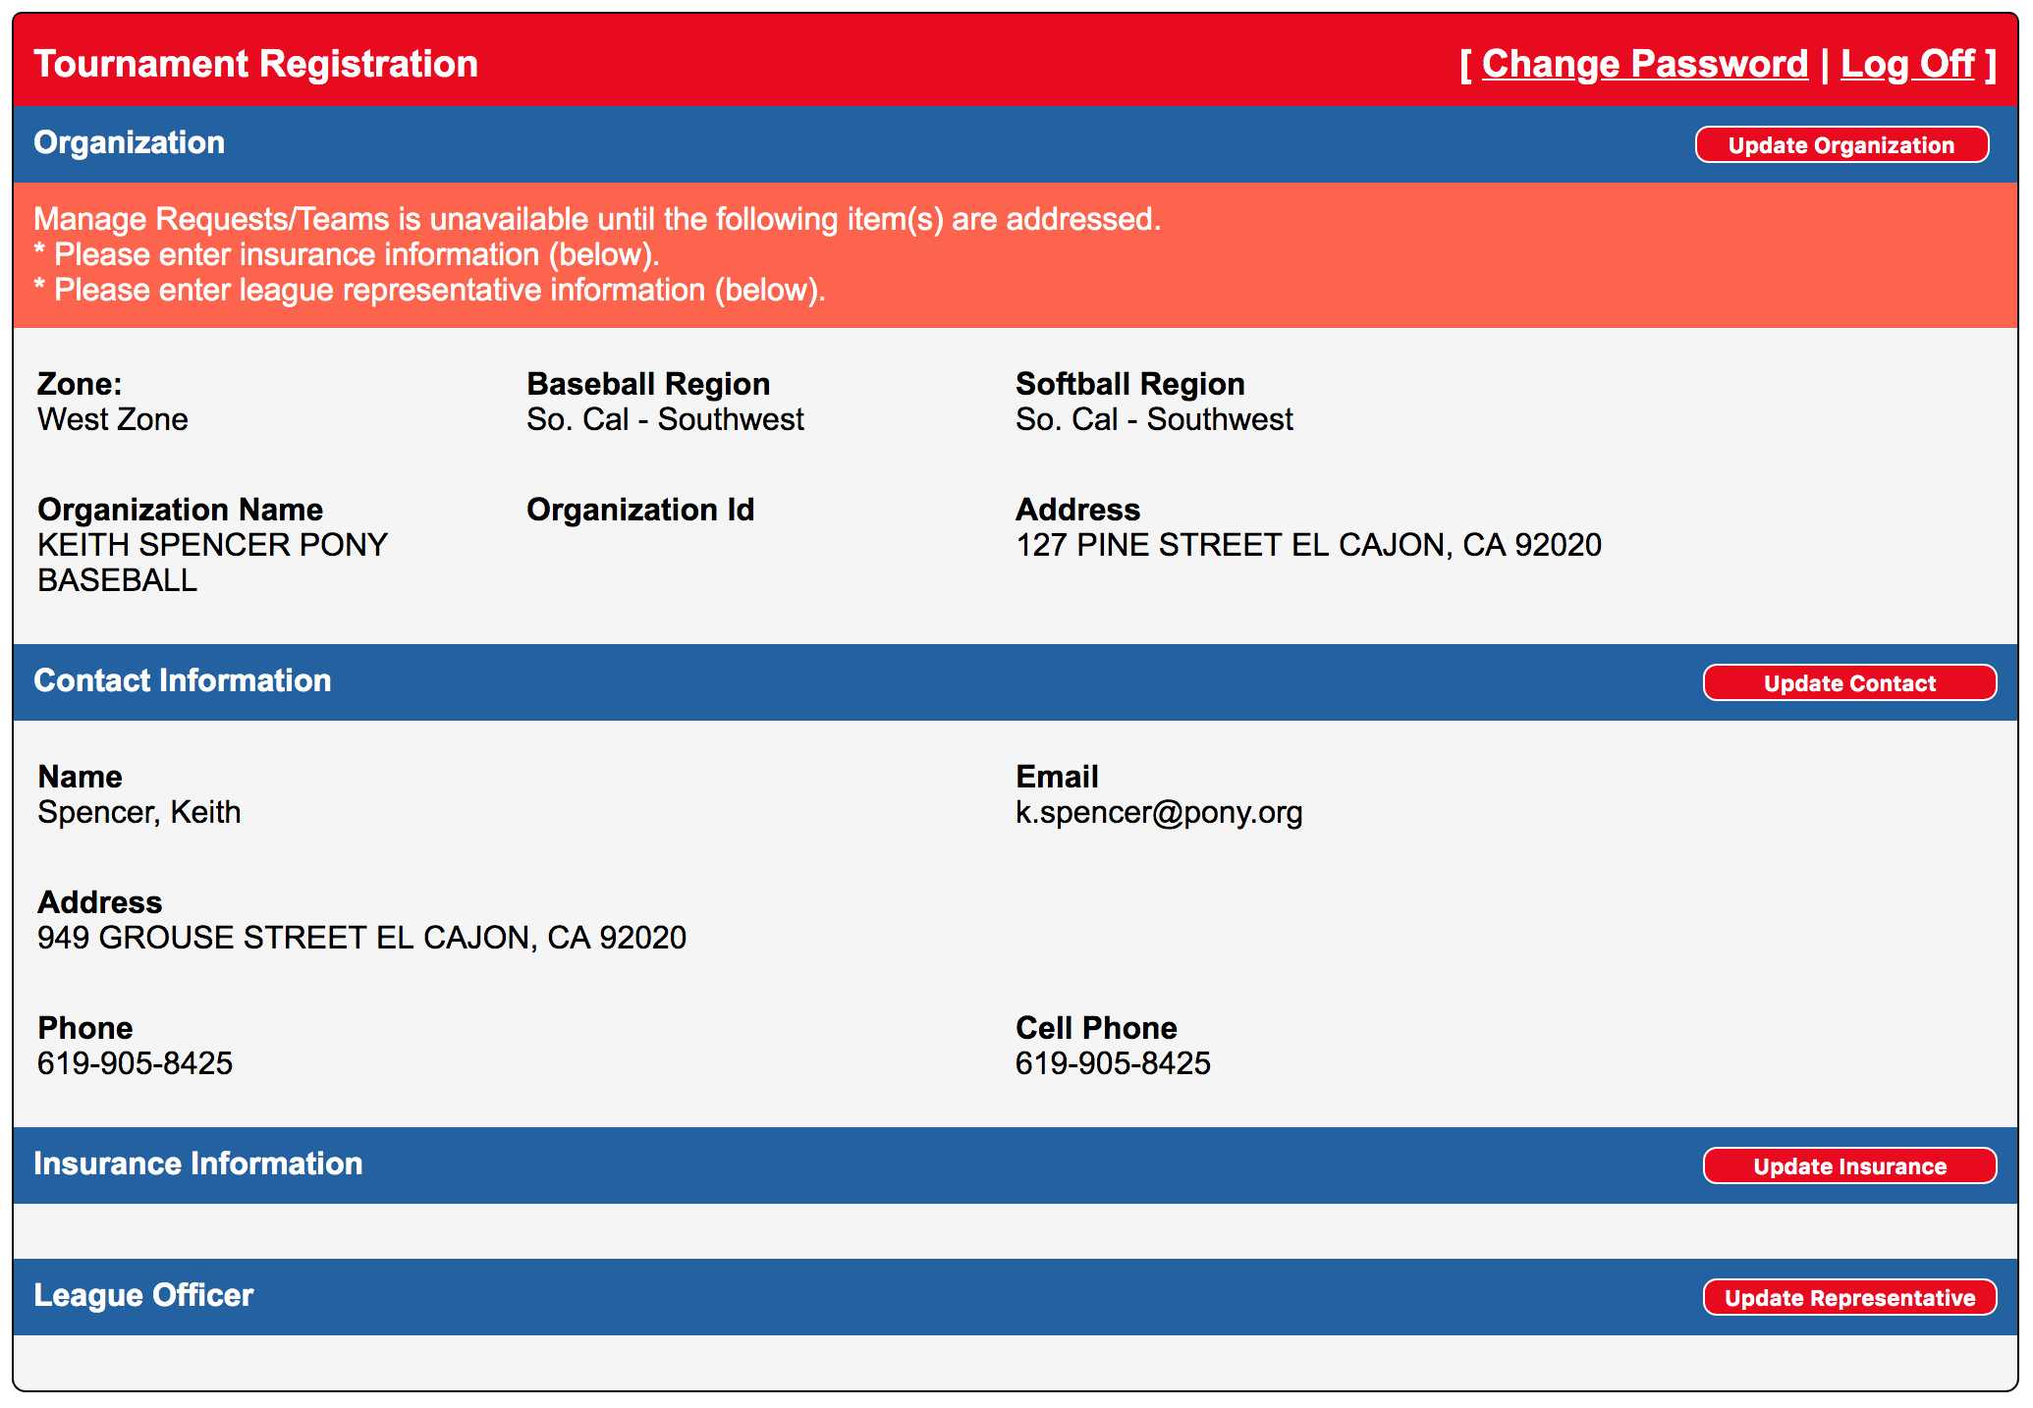
Insurance & Contact Information
Needs To Be Updated

Slide 17
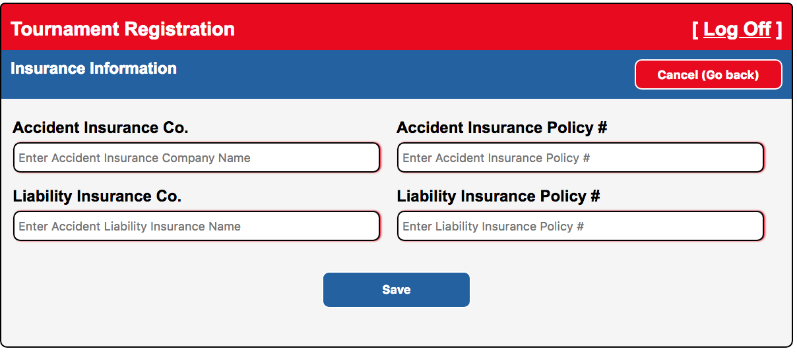
Update Insurance Information
Click on Save
These are normally 2 different policy numbers. Please verify

Slide 18
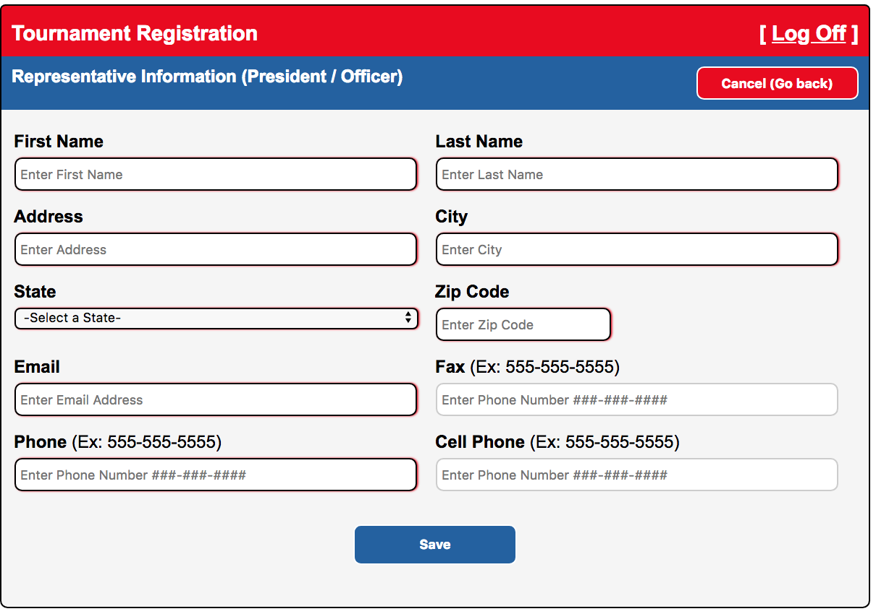
Update Contact / Representative Info
Click on Save

Slide 19
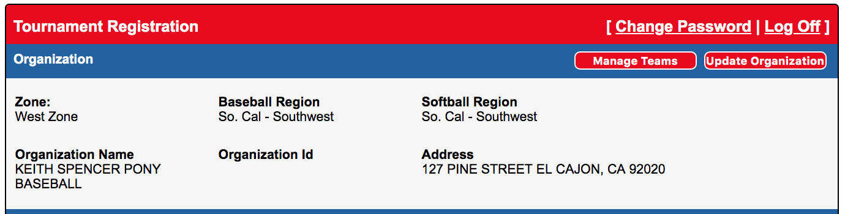
ADD Teams
Click on “Manage Teams”

Slide 20
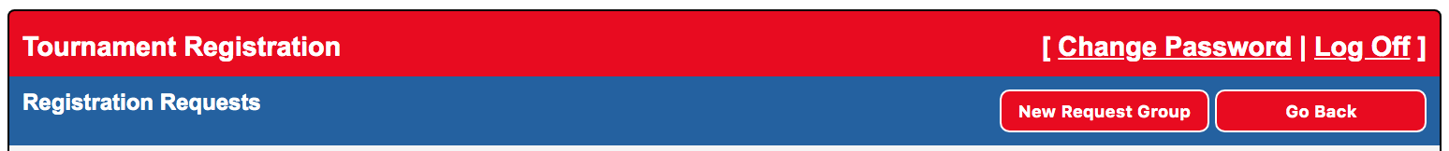
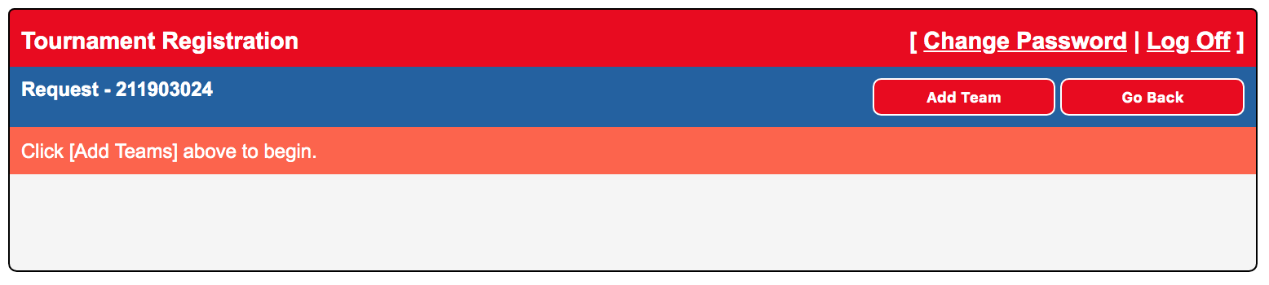
Click New Request Group
Creates Affidavit ID number (League Specific)

Slide 21
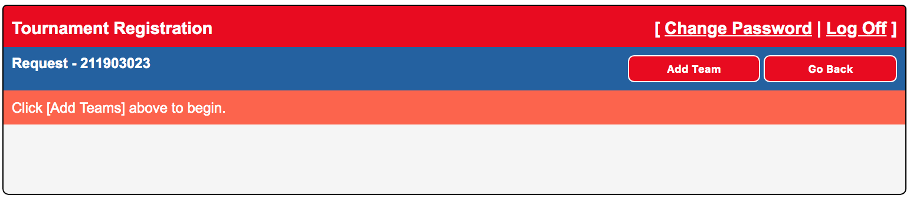
Begin Adding Teams
Click on Add Team

Slide 22
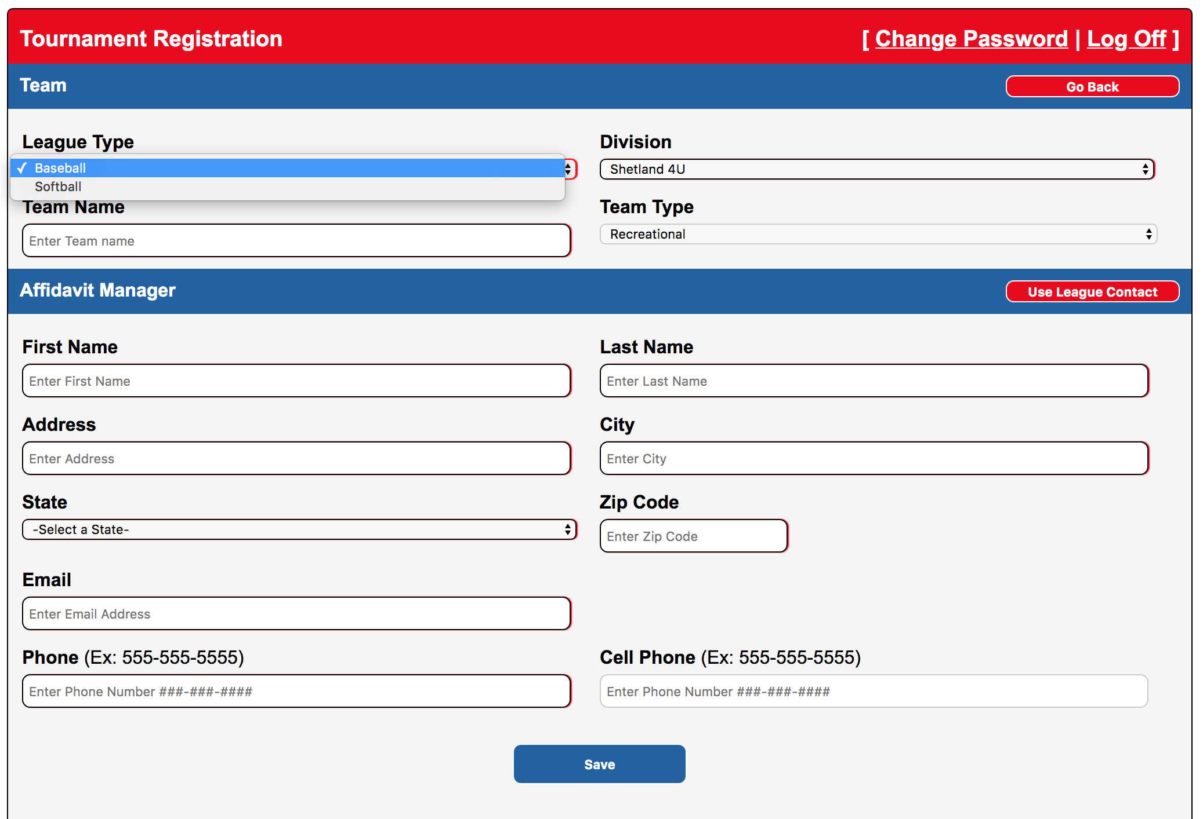
Add Teams Individually
Select/Enter Information In Each Field

Slide 23
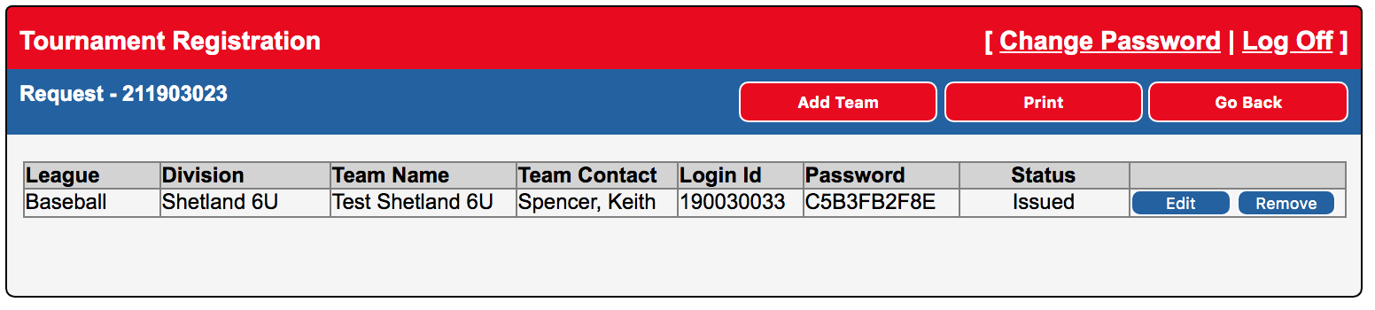
Team List Building
Add Additional Teams
Login Id and Password Created for each team

Slide 24
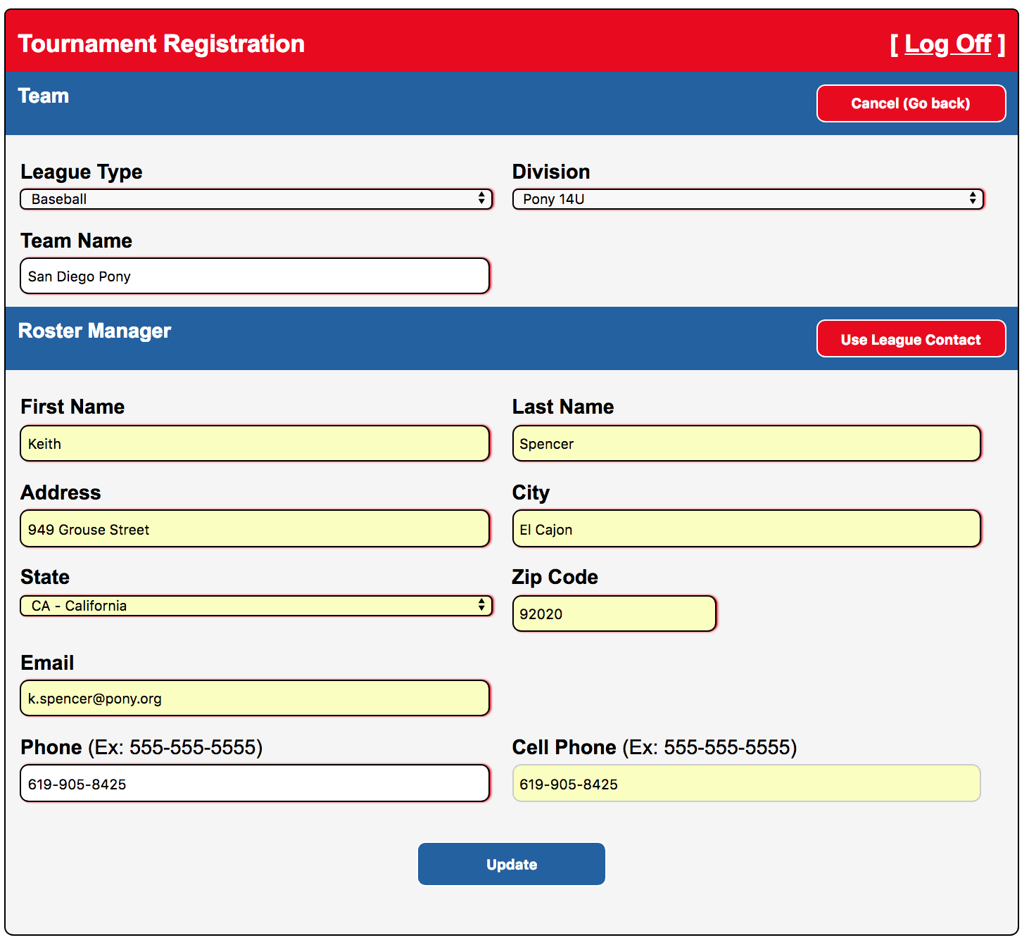
Continue Adding Teams

Slide 25
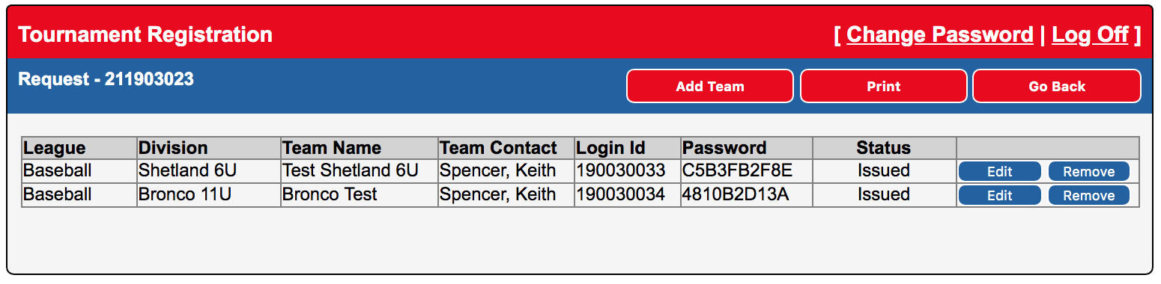
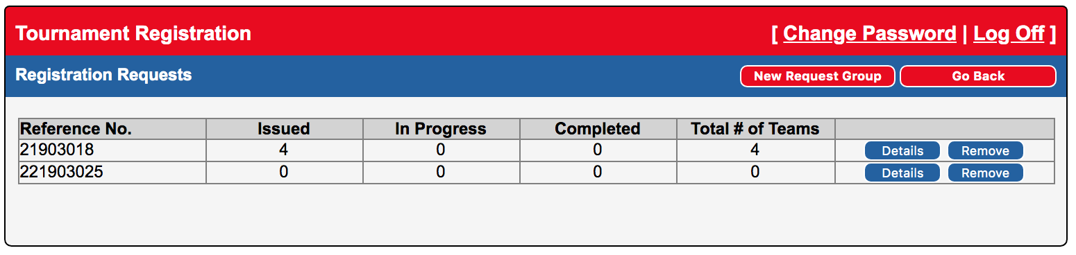
If You Click on Go Back

Slide 26
Log Out After All Teams Added
Retain Logins and Passwords
Next step will be for manager / rep to enter manager and coach information
Enter Player information
Enter Parent information
Submit Affidavit
Print / Email Affidavit
Have Affidavit signed by President/League Rep
Have Affidavit signed by PONY Director

Slide 27
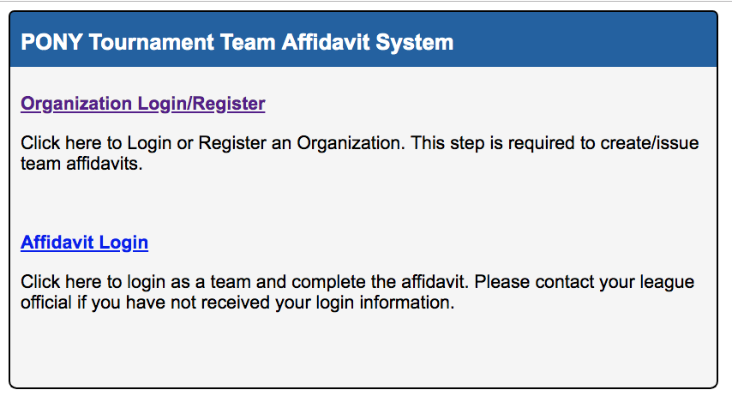
Manager/Rep Can Build Affidavit
Click On Affidavit Login

Slide 28
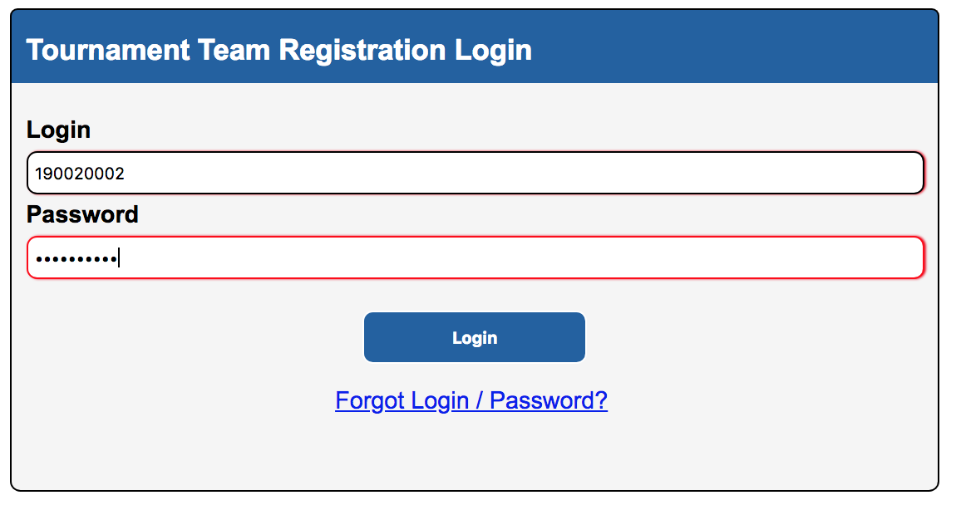
Use Information Sent By President or Received in Email

Slide 29
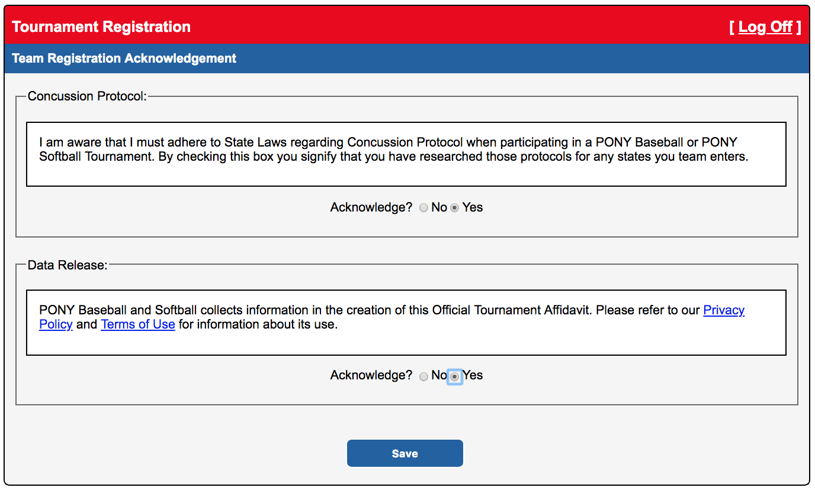
Team Acknowledgements
Manager/Team Rep must acknowledge
Concussion Protocol and Data Release Information Awareness

Slide 30
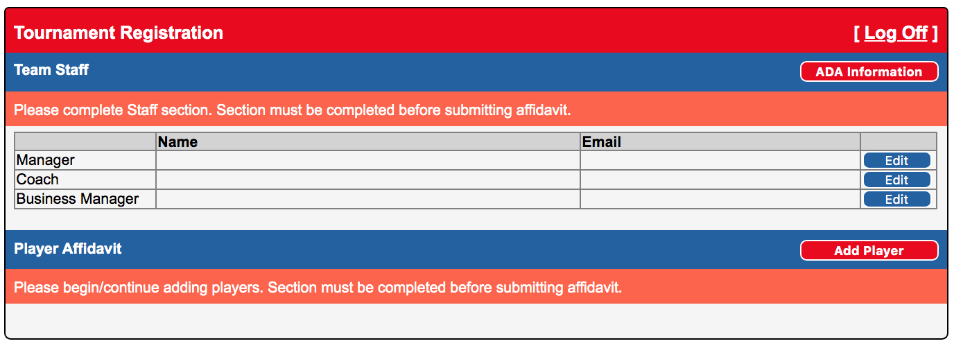
Click on ADA Information

Slide 31
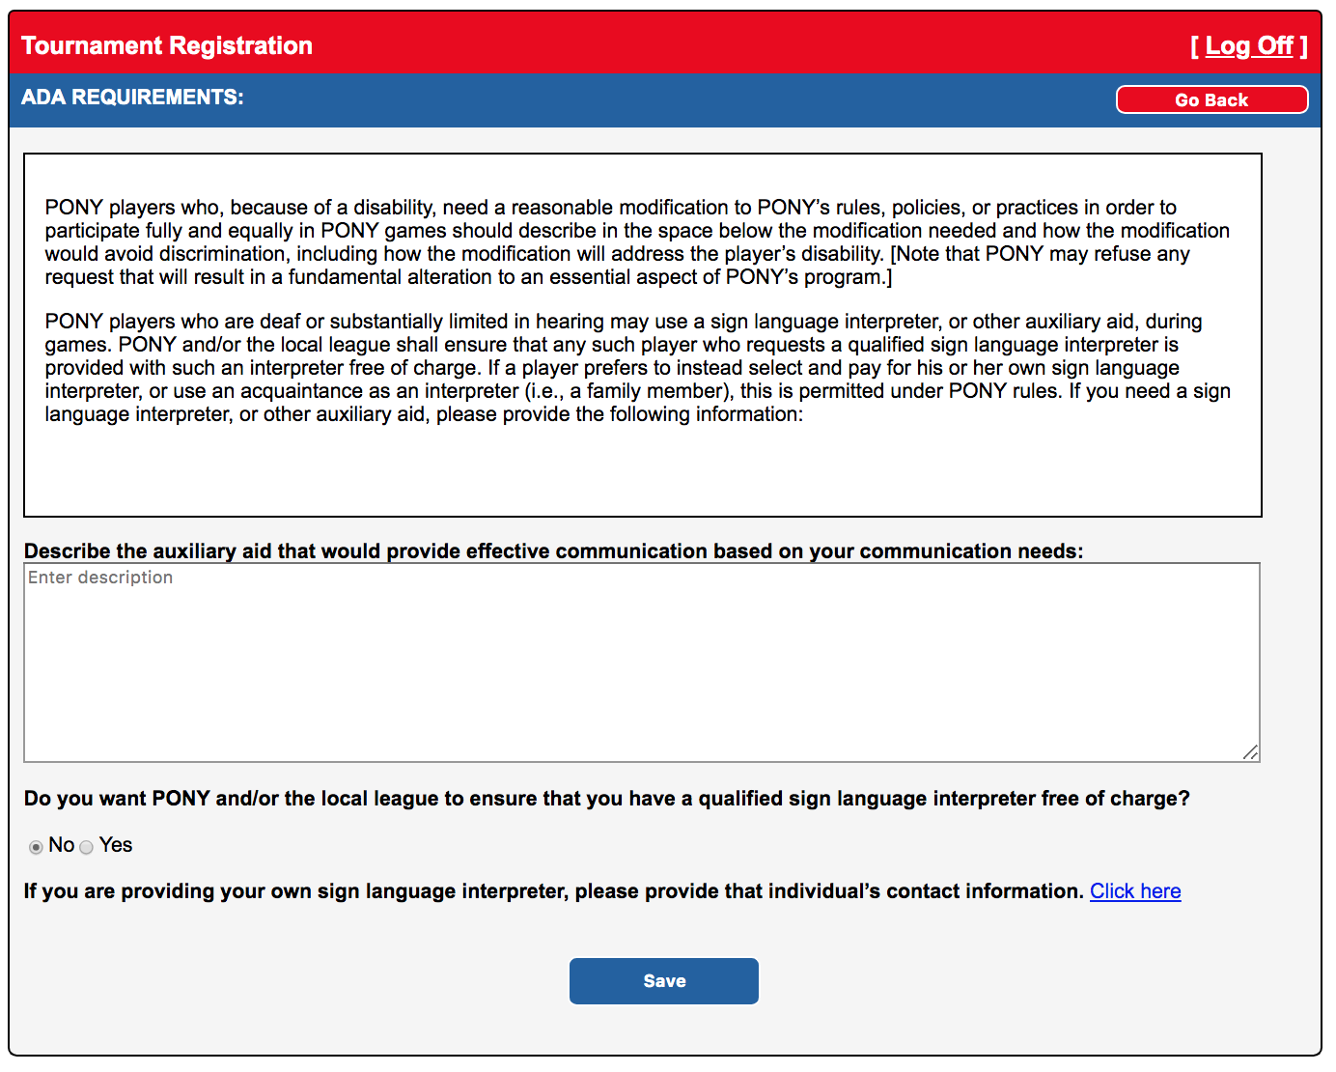
Enter/Acknowledge
ADA Information

Slide 32
Click Edit to ADD Manager, Coach & Business Manager Information

Slide 33
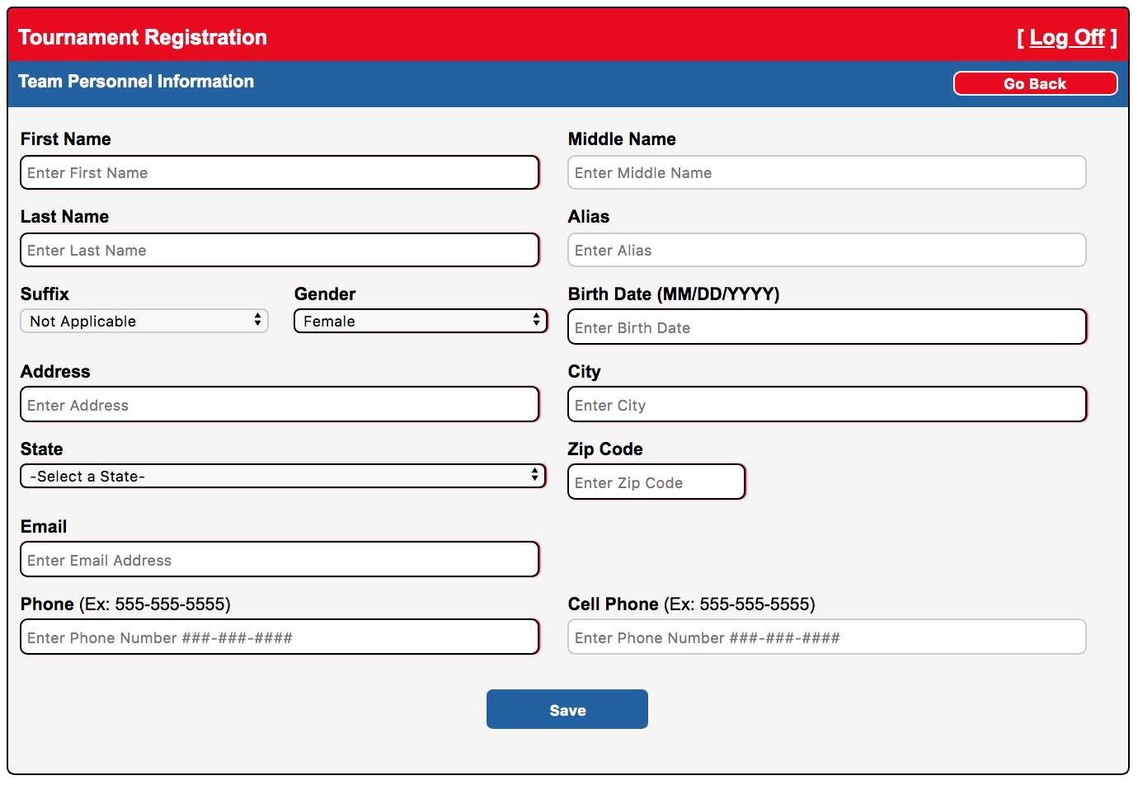
Click Save After Adding Manager, Coach & Business Manager Information

Slide 34
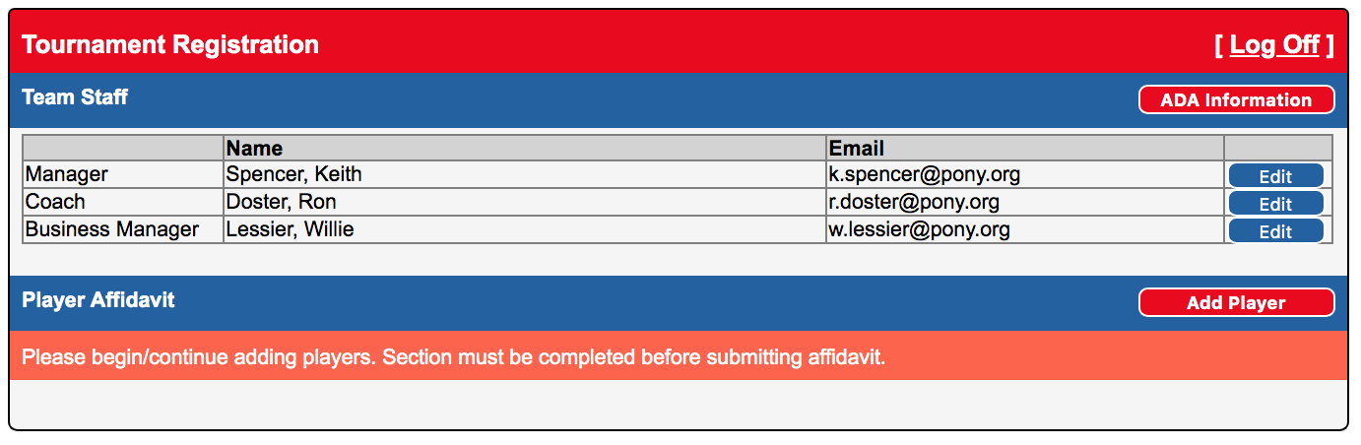
Manager, Coach & Business Manager Information Complete

Slide 35
Begin Adding Players
Click on Add Player

Slide 36
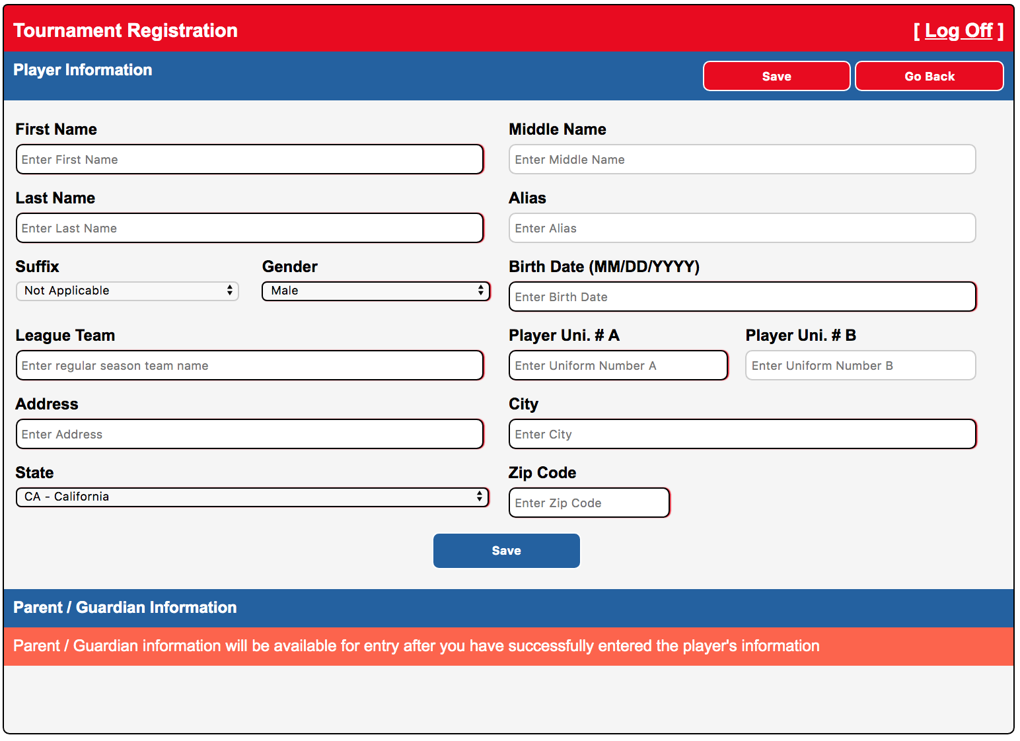
1. Add Player Information
2. Parent Information after Player info
Enter information EXACTLY as written on proof of birth document.
No Nicknames. Middle Names are Required unless none

Slide 37
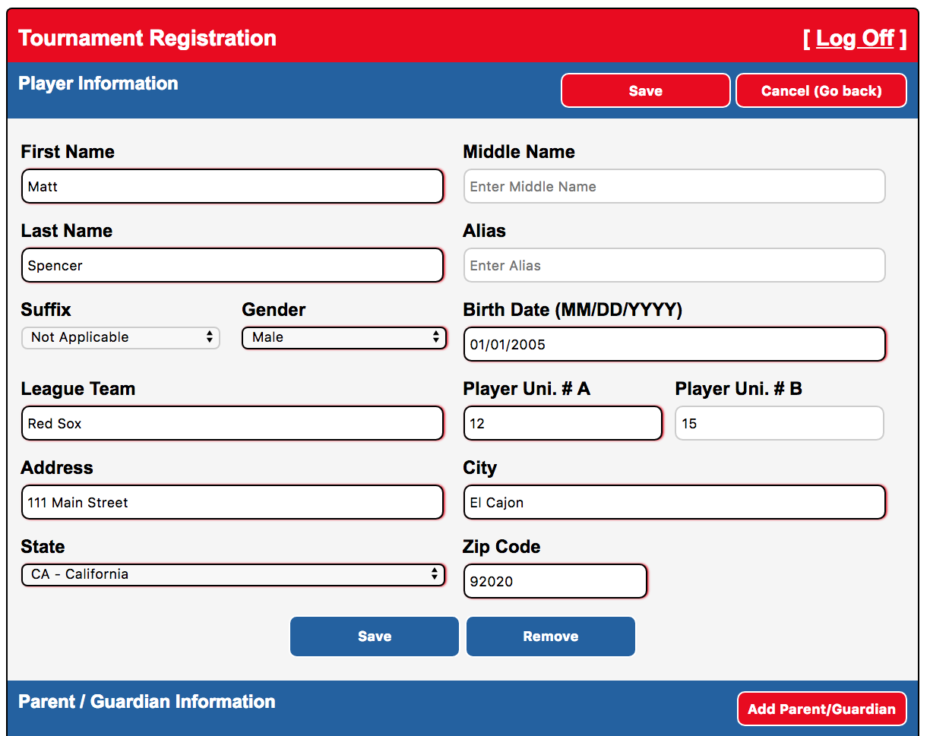
Click on Add Parent/Guardian

Slide 38
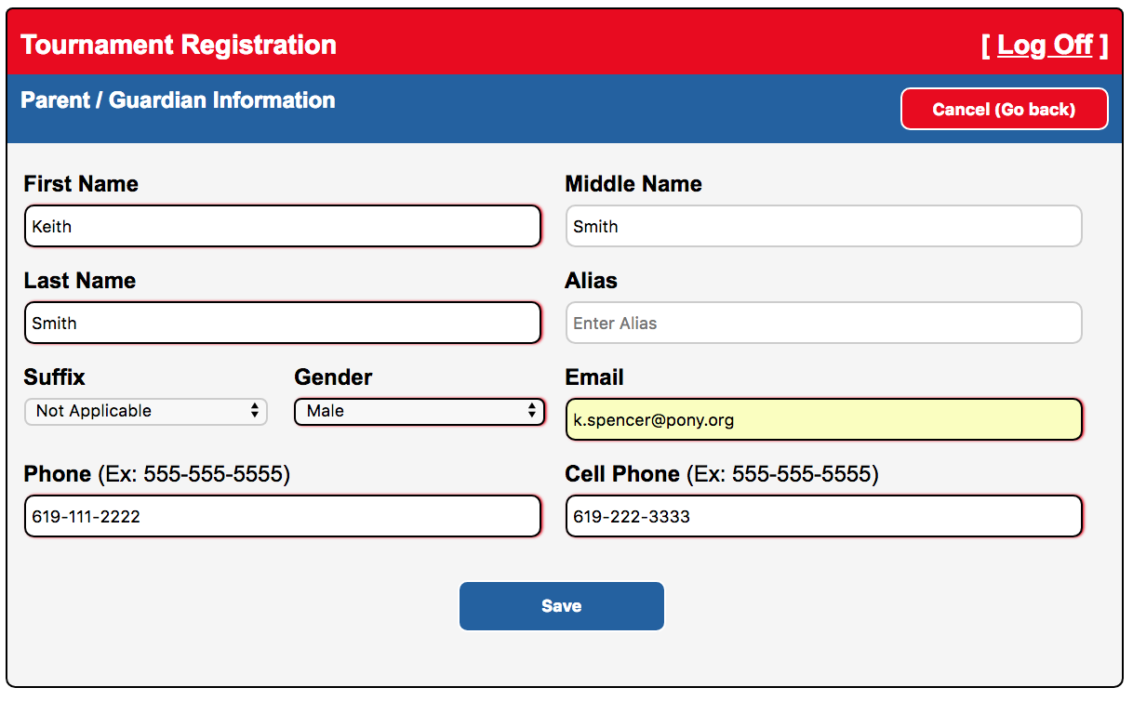
Add Parent/Guardian Info and
Click on Save

Slide 39
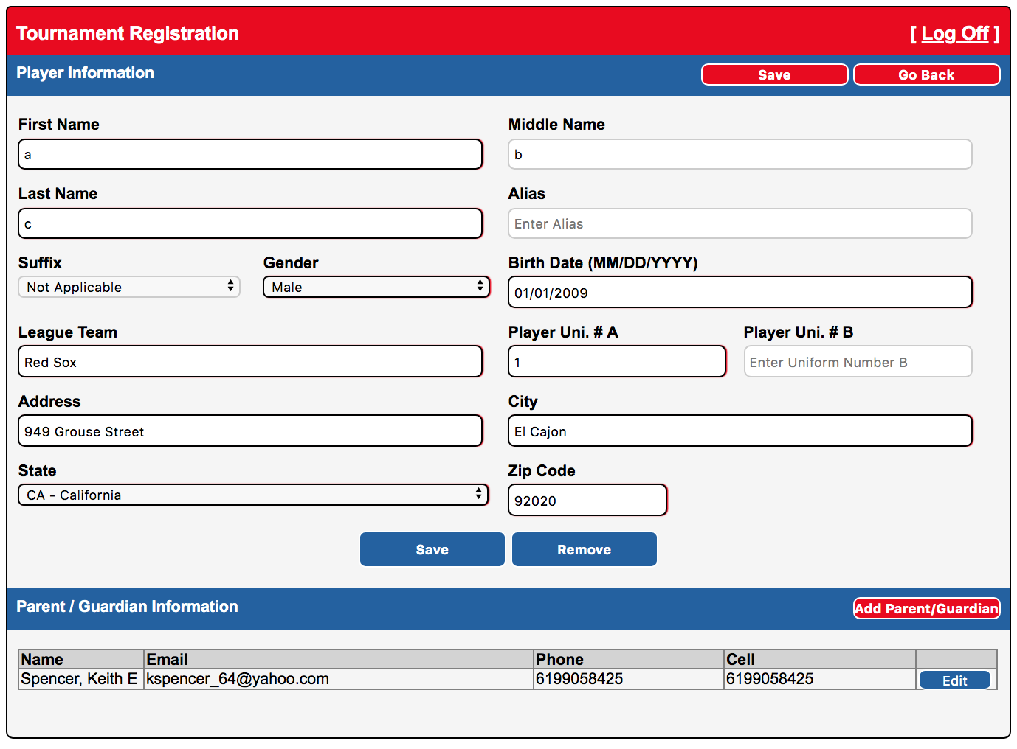
Parent Info Added
Click on Go Back to Add More Players

Slide 40
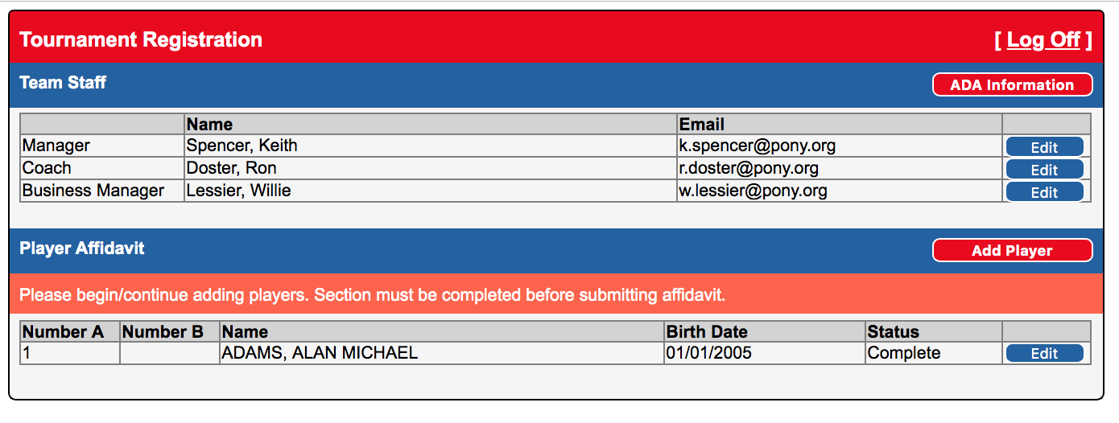
Continue Adding Player / Parent Info
Enter minimum number of players required to complete affidavit

Slide 41
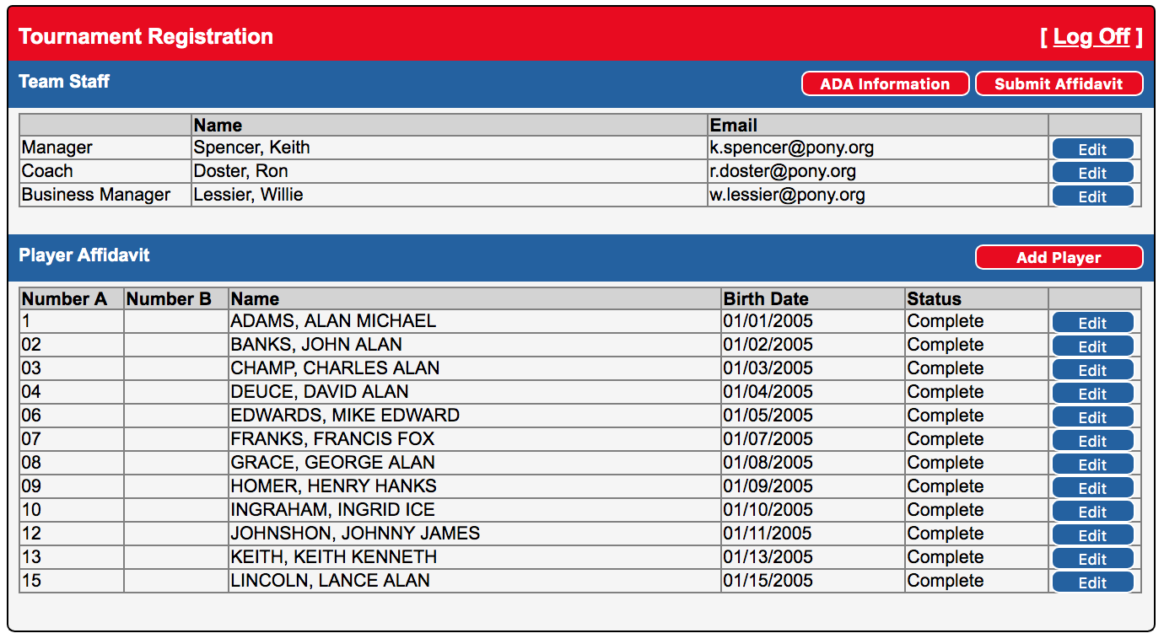
Click on Submit Affidavit When Affidavit is Complete

Slide 42
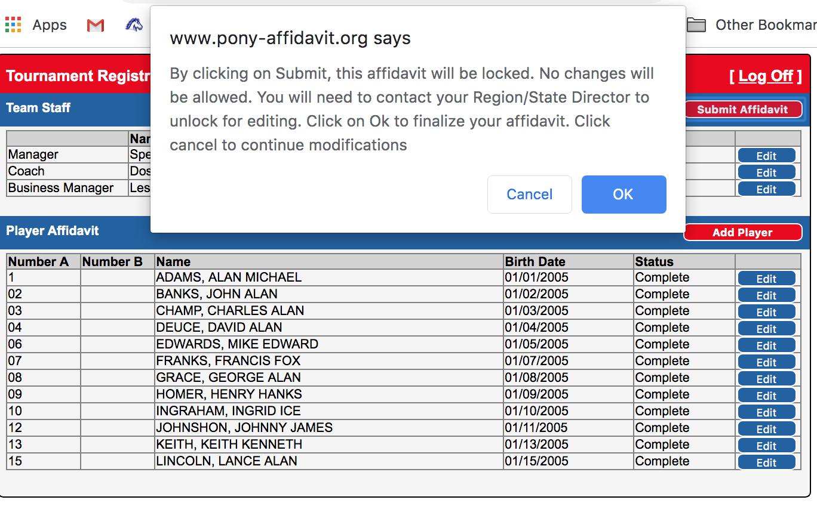
After Clicking on Submit Affidavit You Are Locking The Affidavit

Slide 43
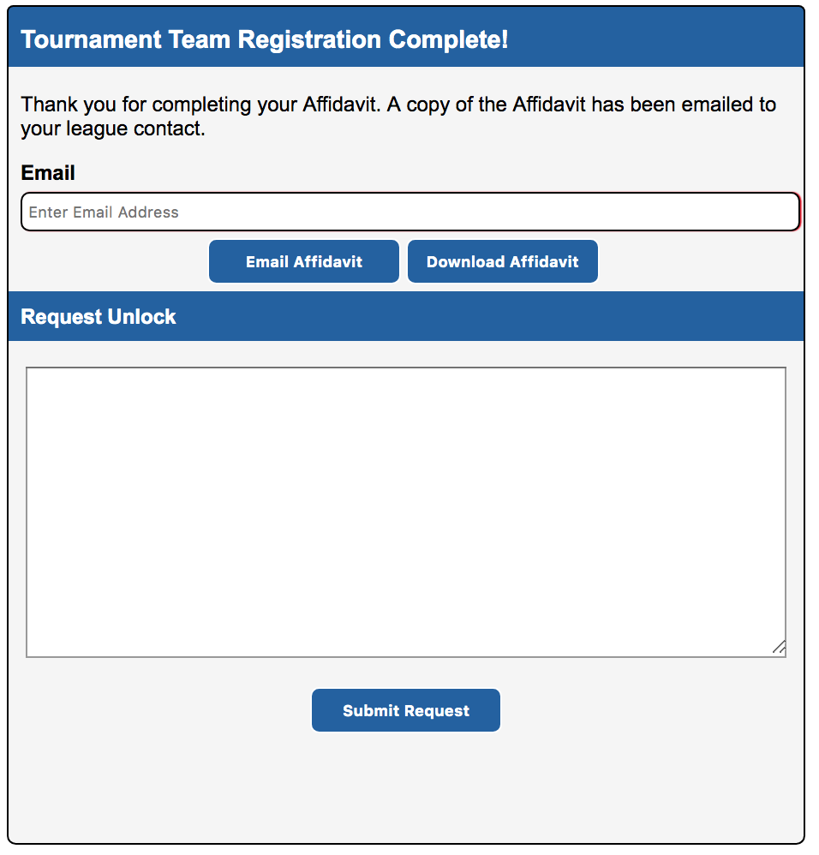
Email / Download / Unlock Affidavit

Slide 44
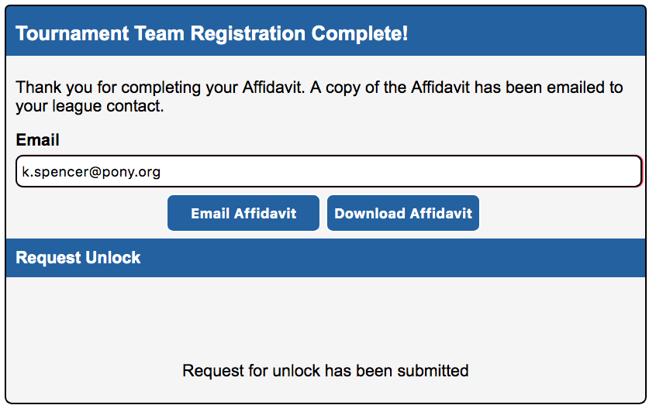
Unlock Request Sent

Slide 45
Affidavit Printed

Slide 46
Medical Release page

